Slide 1



Secure your letter head with security features.

Slide 2

We are Introducing ourselves as one of the leading Supplier of Letter Head with Security Features.

Slide 3
Our Offering to Corporate Sector.
Letter Head with Security Features
Envelope
Welcome Kit
Blank Sticker
Barcode Sticker
Barcode Ribbon
Registers
Diary
Any Confidential Document

Slide 4
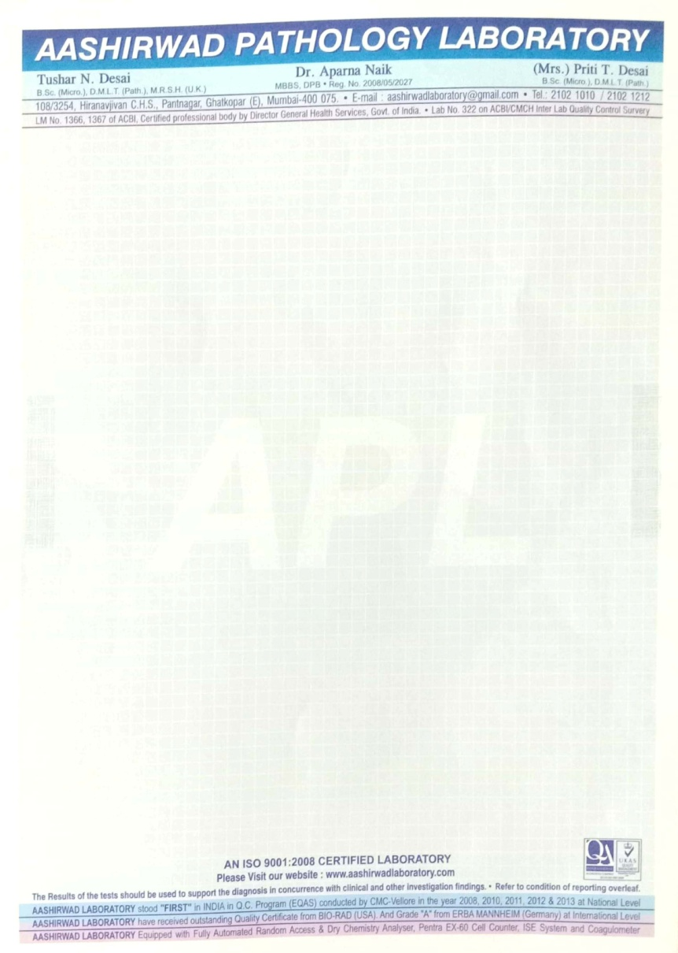
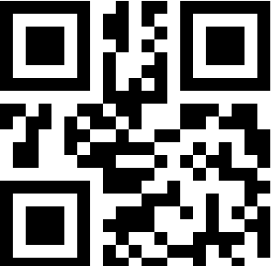


Printing of Letter Head with Security Features
Micro Line
Water Mark
Printing
SAMPLE
Copy /Void
Copy /Void
Invisible
Confidential
PRINCIPAL

Slide 5
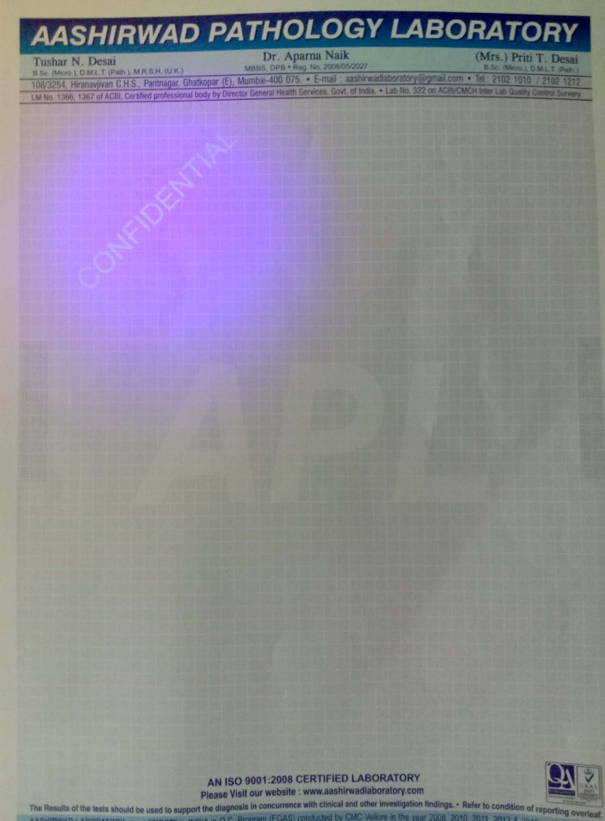
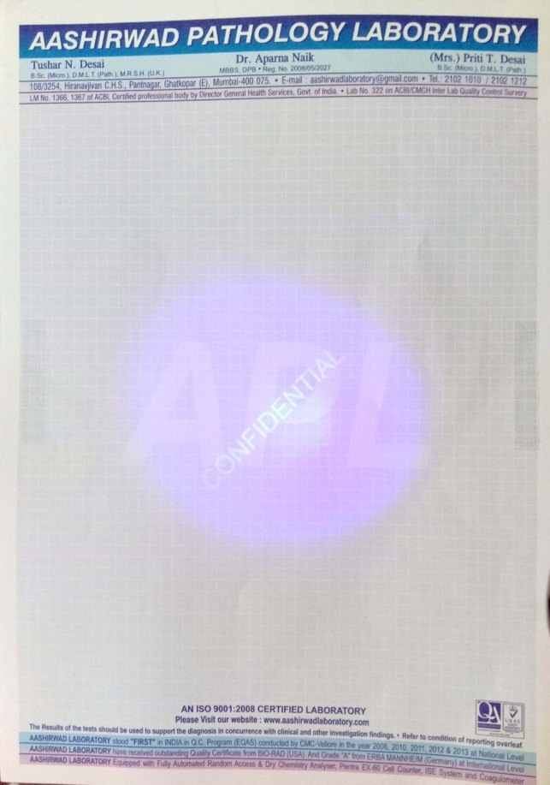
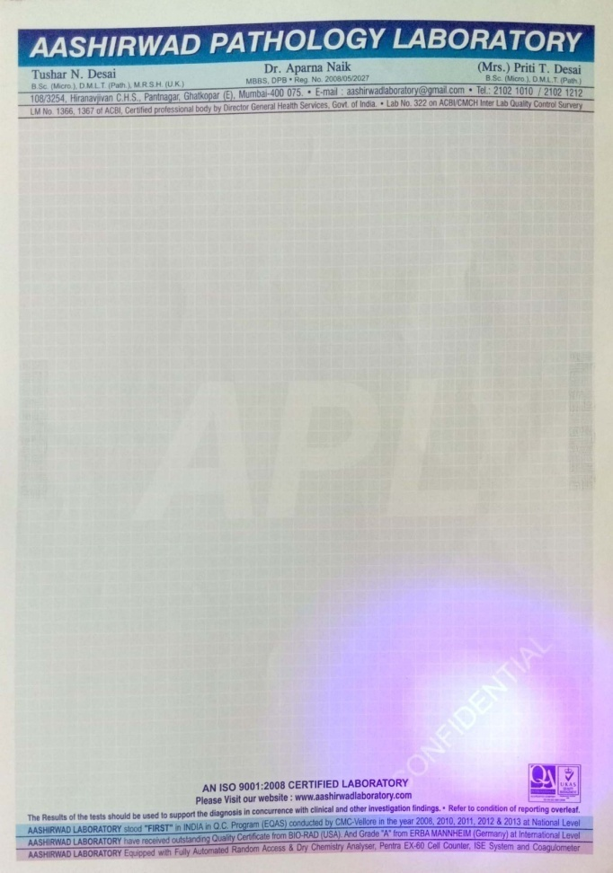
Letter Head With Security Marking
Invisible
Confidential
Invisible
Confidential
SAMPLE
SAMPLE
SAMPLE
Invisible
Confidential

Slide 6
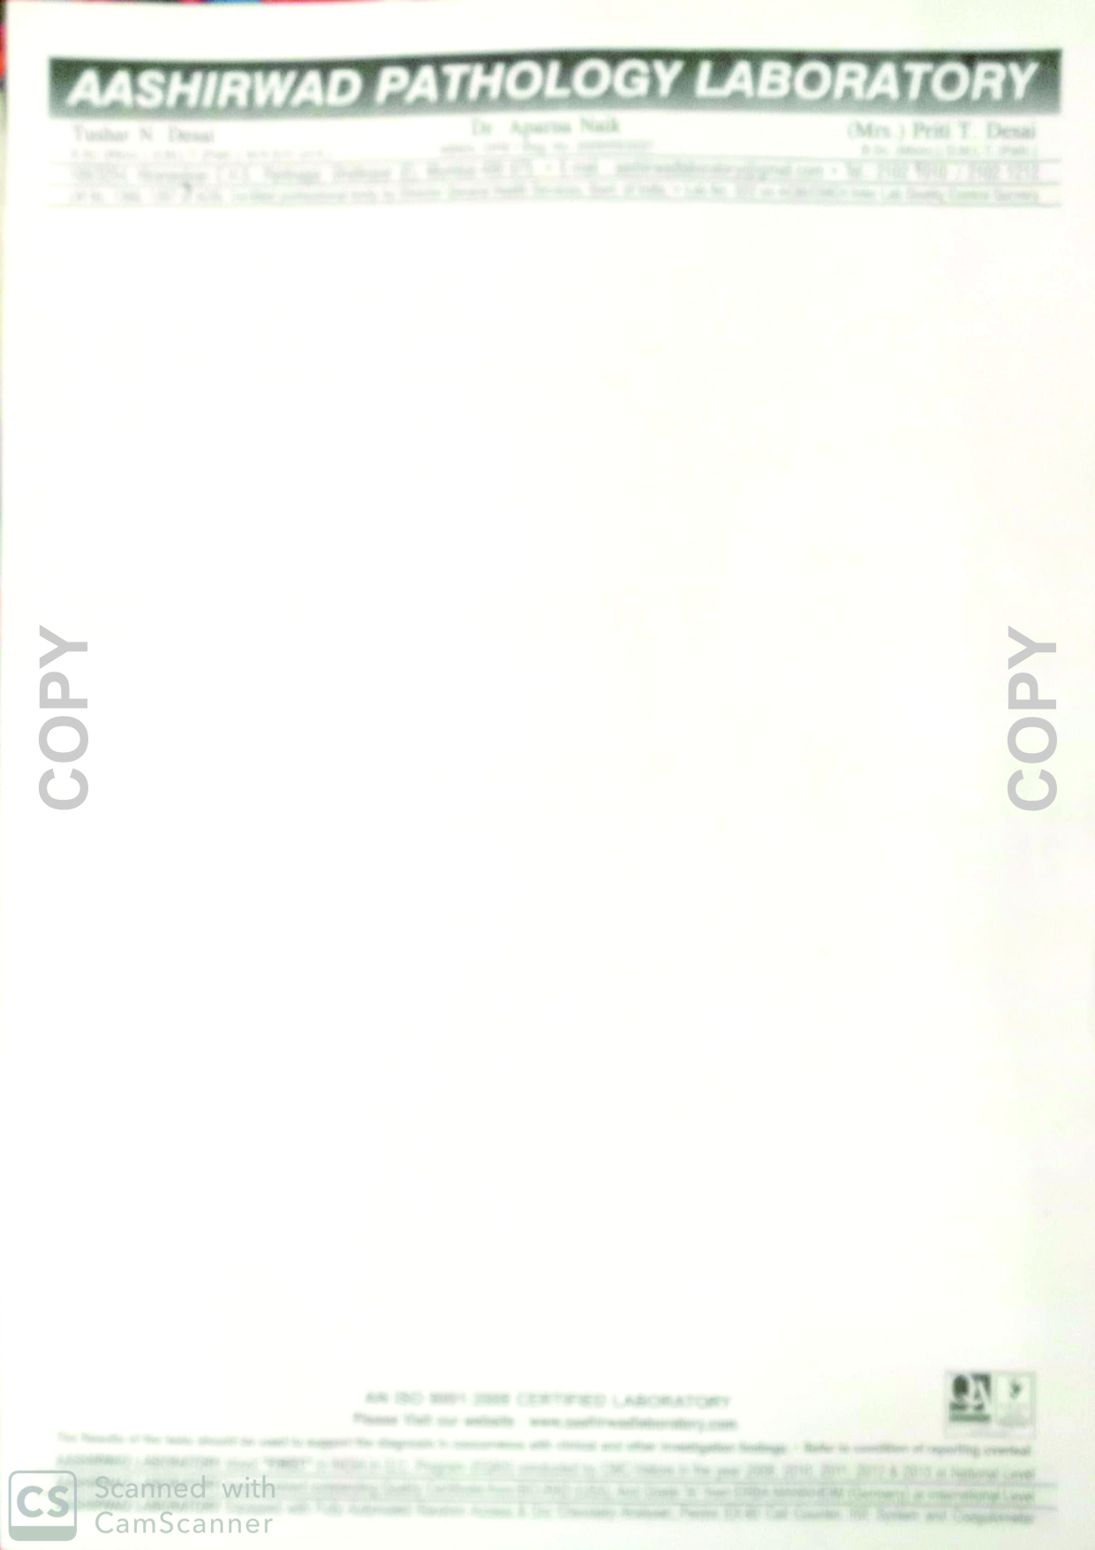
When we take the Xerox of the Letter Head the Copy/Photo Copy word will Automatic Come with the xerox copy
Copy/Photo Copy Features
SAMPLE
Copy/Photo Copy Features

Slide 7
Benefit of Printing of Letter Head with security Features From SKT
No duplication Easily
No Cost Difference
Maintain Secrecy.

Slide 8
CONTACT
SKT SOLUTION
103, Bldg. No. B12
Queens Park, Mira Bhyandar Road
Mira Road(E), Thane -401107. INDIA
Email: sktsolution82@gmail.com
Website:- www.sktsolution.in
Mob- 09867859188 ,7304806908

